Slide 1
PvD Troubleshooting and Support
Shane Broomhall
APAC Readiness

Slide 2
Troubleshooting, Support & Advanced Configuration
Logging enabled by default
PvD maintains a number of logs on the Citrix Personal vDisk drive, also known internally as the PUD (Persistent User Drive) and on the system volume
  Remember - the PUD drive letter is assigned during catalog creation in DS or PoSH (Default = P:\)
These logs contain lots of information that should be captured and provided to support/engineering if customers experience problems with their personal vDisks
Lets take a closer look…
Notes:
Notes:
In earlier versions of RingCube, the default drive letter was set to E as can be clearly seen from the above screenshot. There is no technical reasoning behind the change. P: just seems a better fit by default i.e. P for personal…
Going forward…
There are plans to move to CDF/CDE/ETW logging but this didn’t make it into the product in time for Ibiza. Further, PvD starts so early that some of those subsystems aren’t even available when PVD needs to log information. More work needs to be done in this area…

Slide 3
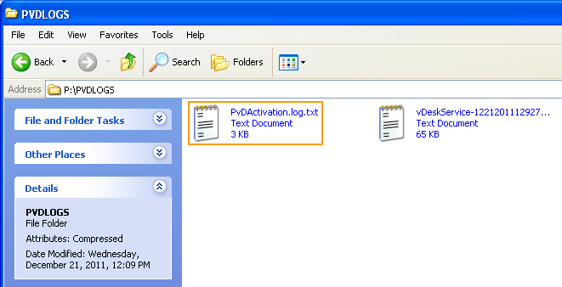
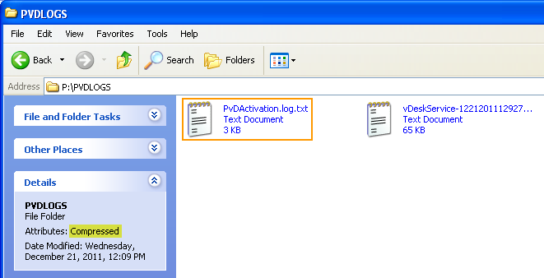
PvDActivation.log.txt
Located under the PVDLOGS folder on the root of the PUD
Contains information in relation to initial PvD configuration
Generated by CitrixPvD service (CtxPvDSvc.exe)
PVDLOGS folder is compressed to save space
Notes:
PvDActivation.log.txt contains information in relation to initial PvD configuration such as:
-Any features explicitly disabled e.g. UserVPN
-vDisk re-sizing details
-Catalog creation
-Junction point creation for %userprofile%

Slide 4
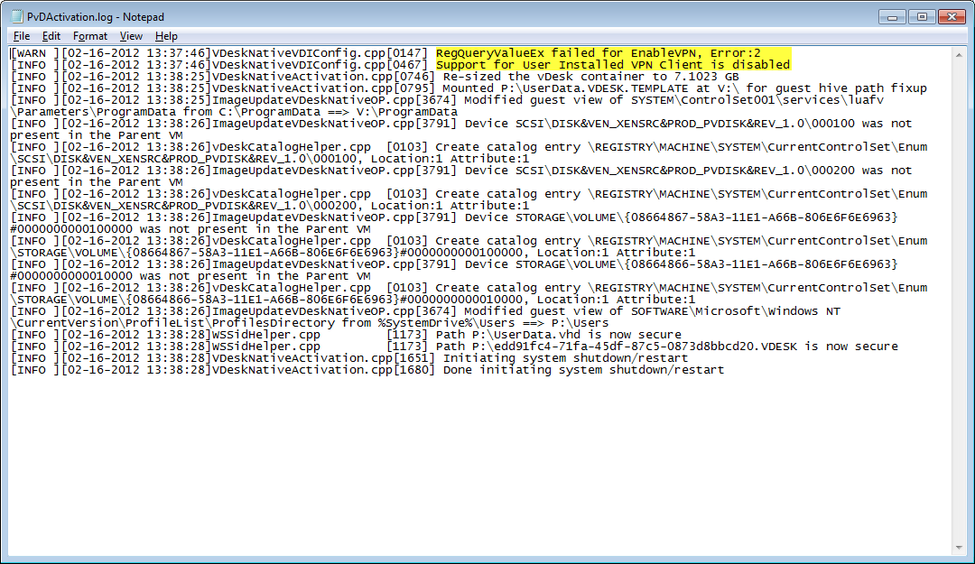
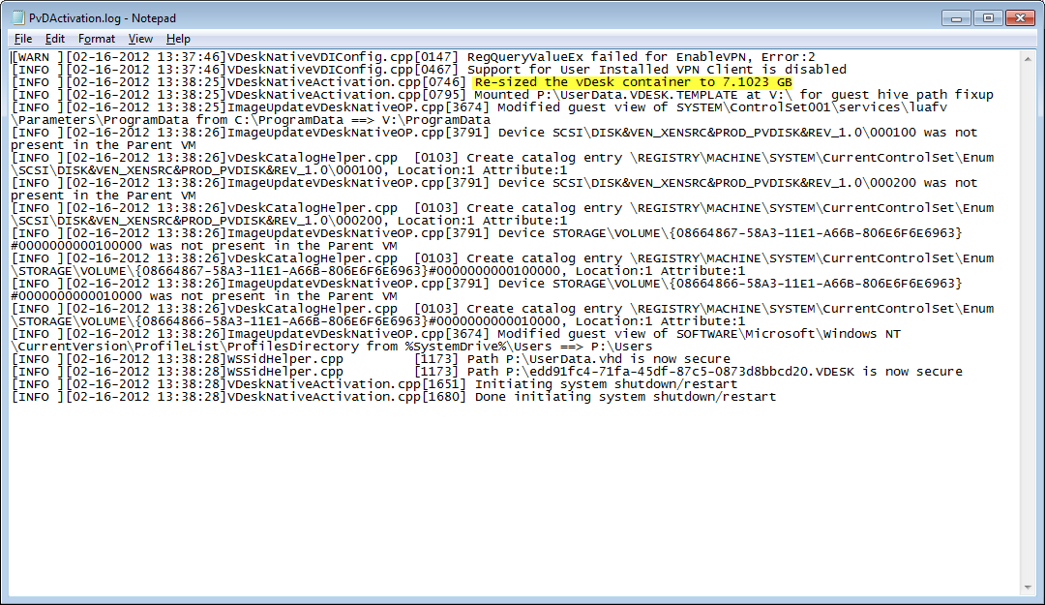
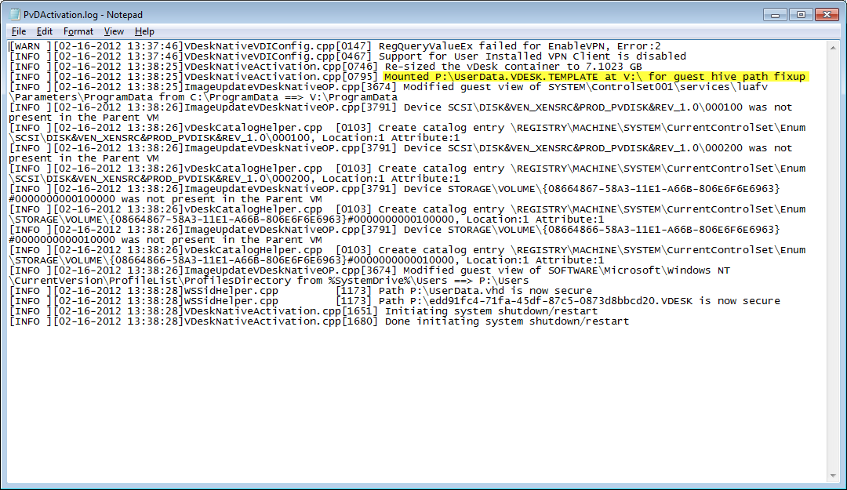
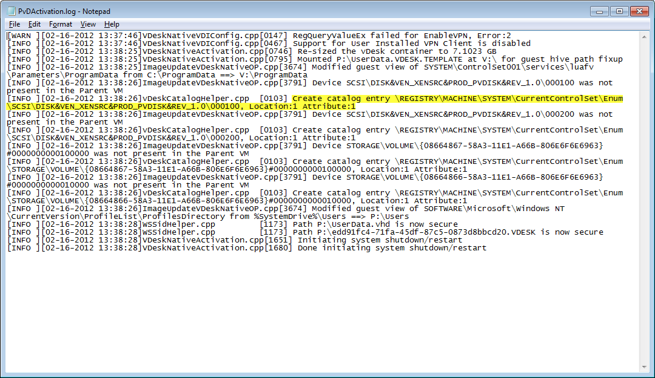
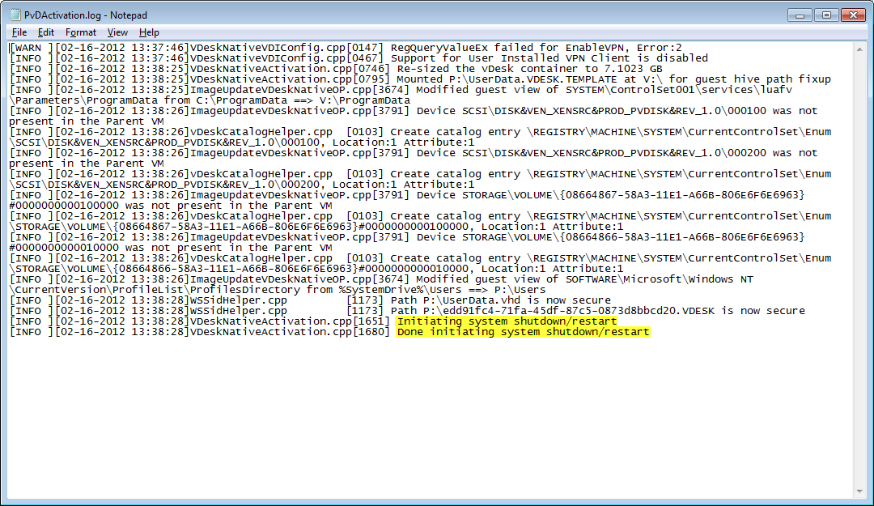
PvDActivation.log.txt - Walkthrough…
Disable user installed VPN
Resize vDesk container based on user/app ratio
Mount the template vhd to v: to prep for hive fix-up
Create catalog entries in registry
Complete initial configuration
Notes:
Notes:
Any instance of “vDesk” in the logs or installed components is a reference to the original product name “RingCube vDesk for VDI”
before it was acquisitioned by Citrix
Resizing the “vDesk container” or Citrix Personal vDisk (PUD) is carried out so that users see the correct amount of available space to save application data. The available space on the PUD is split 50/50 by default between user data and application data and the resizing occurs so that users are not misled to believe they have more space to install and manage applications then they actually have.
The UserData.vhd.thick_provision file is a dummy file used to facilitate the resizing process.
The Free space for application data on the PUD is calculated as follows:
Free space = 50% of PUD minus the size of the UserData.vhd file

Slide 5
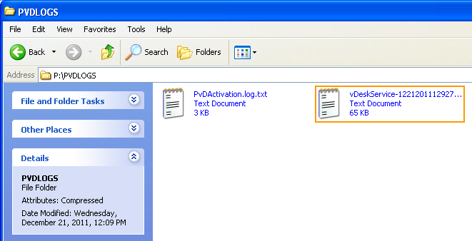
vDeskService-<#>.log.txt
Located under the PVDLOGS folder on the root of the PUD
Contains detailed information about initial VHD/inventory creation and image update processing on a per-vm basis
Generated by CitrixPvD service (CtxPvDSvc.exe)
Captures all subsequent inventory operations…
Notes:
PvDActivation.log.txt versus vDeskService.log.txt
*difference is the activation log is only for first time setup and service log is running, so it captures subsequent inventory operations*

Slide 6
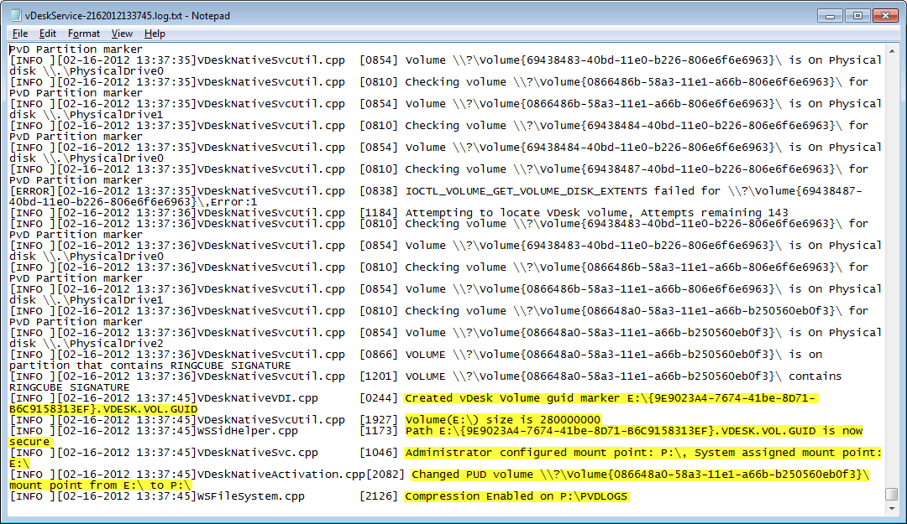
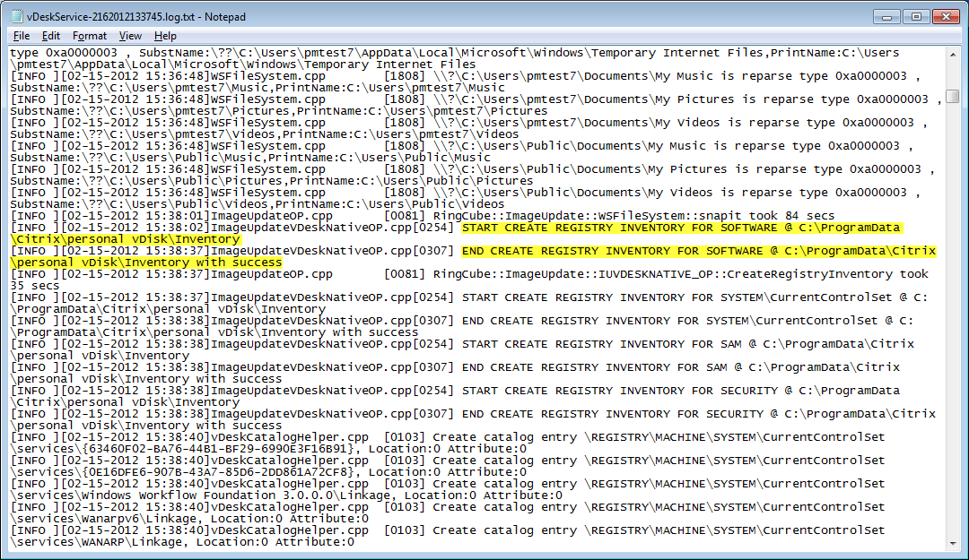
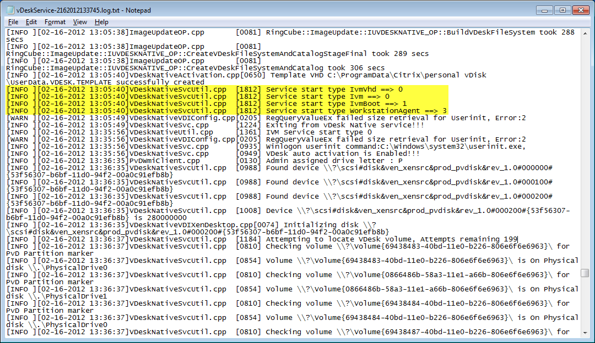
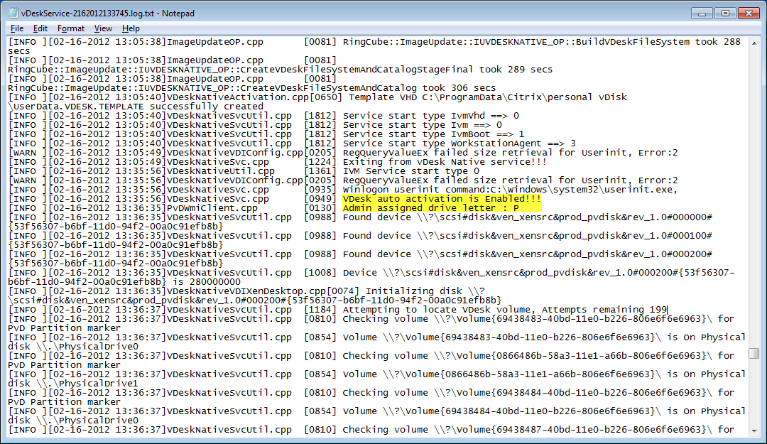
vDeskService.log.txt - Walkthrough
Track Inventory process
Start services based on start-type 0,1 & 3
Activate PvD and assign P: drive letter to PUD
Configure PUD volume and enable compression on PVDLOGS folder
0: SERVICE_BOOT_START (Ivm & IvmVHD)
1: SERVICE_SYSTEM_START (IvmBoot)
3: SERVICE_DEMAND_START (workstationAgent)
Notes:
Ref:
http://msdn.microsoft.com/en-us/library/windows/hardware/ff557272%28v=vs.85%29.aspx
Service Start-Types:
SERVICE_BOOT_START (0x00000000) Indicates a driver started by the operating system (OS) loader. File system filter drivers commonly use this start type or SERVICE_DEMAND_START. On Microsoft Windows XP and later systems, filters must use this start type in order to take advantage of the new file system filter load order groups.
SERVICE_SYSTEM_START (0x00000001) Indicates a driver started during OS initialization. This start type is used by the file system recognizer. Except for the file systems listed below under "SERVICE_DISABLED," file systems (including network file system components) commonly use this start type or SERVICE_DEMAND_START. This start type is also used by device drivers for PnP devices that are enumerated during system initialization but not required to load the system
SERVICE_DEMAND_START (0x00000003) Indicates a driver started on demand, either by the PnP Manager (for device drivers) or by the Service Control Manager (for file systems and file system filter drivers).

Slide 7
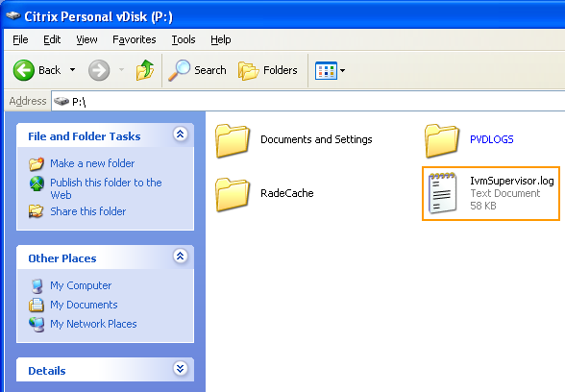
IvmSupervisor.log
Located on the root of the PUD & system volume
Created by the IVM PvD driver and logs what IVM.sys did during very early boot, which PUD it found, which VHDs it considered, resized etc…
Captures early boot messages…
Notes:
Notes:
-IvmSupervisor.log = The PVD driver/ivm.sys (core) log
-Log messages from IVM.sys basically stop after the drivers have been booted/VHD mounted/catalog hive loaded/etc.

Slide 8
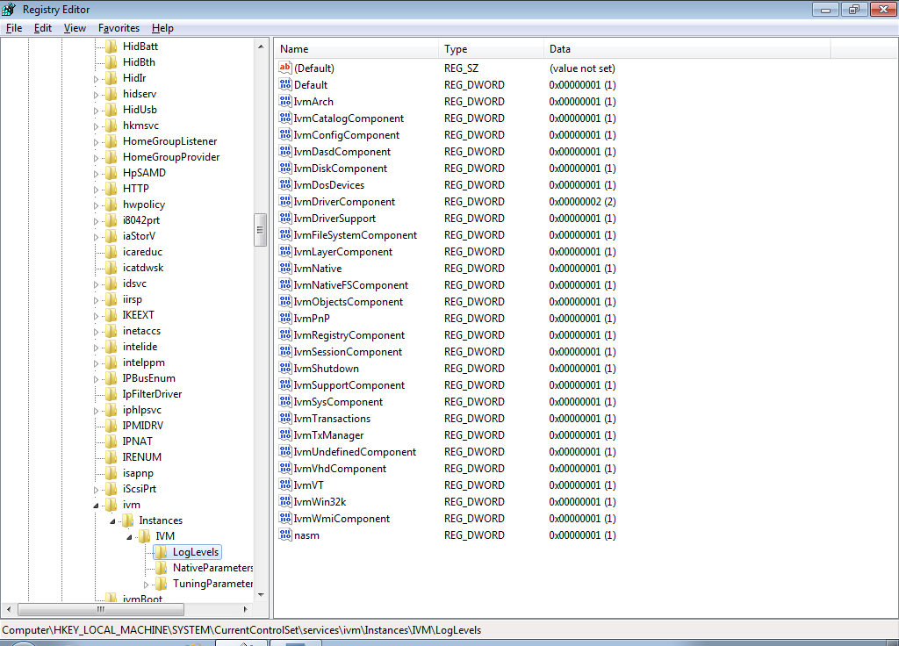

Ivm.sys advanced Logging (IvmSupervisor.log)
More verbose logging can be enabled by editing the values for specific modules under
  HKLM\SYSTEM\CurrentControlSet\services\ivm\Instances\IVM\LogLevels
  Default = 1 <INFO>
  HKLM\SYSTEM\CurrentControlSet\services\ivm\Instances\IVM\LogLevels
Notes:
INTERNAL: Although the verbosity of the IvmSupervisor.log can be controlled by increasing the values for each individual module of IVM.sys it is not advised. If you bump the log level up it will literally log 5-10 lines of debug for each i/o operation. The machine will run at about 1% normal speed and consume GBs of log space. This is really meant for ivm devs using serial-attached kernel debuggers.

Slide 9
PvDSvc.log.txt & PvDWMI.log
Created by the Citrix Personal vDisk service (CtxPvDSvc.exe) & PvD WMI provider (PvDWMI.dll)
Located and managed in two locations based on the mode PvD is running in:
  *base image mode*
    C:\Documents and Settings or C:Users\All Users\Citrix\personal vDisk\LOGS\PvDSvc.log.txt, PvDWMI.log
  *pool vm mode*
    P:\Documents and Settings or P:\Users\All Users\Citrix\personal vDisk\LOGS\PvDSvc.log.txt, PvDWMI.log
Notes:
Notes:
*base image mode* = logging into Base VM, taking inventory etc
*pool vm mode* = Citrix Personal vDisk attached to logged on Pooled static desktop and managing complete machine state
Above logs can also be found under C:\ProgramData\Citrix\personal vDisk\LOGS

Slide 10
Managing Multiple logs - How it works…
  The logs generated when PvD is running in *base image mode* are copied into the PUD on initial provisioning of VM or image update
    C:\Documents and Settings or C:Users\All Users\Citrix\vDisk\LOGS\PvDSvc.log.txt, PvDWMI.log
These logs are then appended by the PvD service when running in *pool vm mode*
  P:\Documents and Settings or P:\Users\All Users\Citrix\vDisk\LOGS\PvDSvc.log.txt, PvDWMI.log
Notes:
The reason there are multiple log locations is to provide a complete picture from base and pool vm mode and to prevent logs getting lost on reboot … Here’s how it works:
1.The PVD service logs when running in *base image mode* (eg, taking inventory, etc) go into C:\documents and settings\all users\application data\citrix\personal vdisk\logs .
2.The logs from #1 are *copied* into the PVD on first provisioning or image update, into P:\documents and settings\all users\application data\citrix\personal vdisk\logs
3.The logs from #2 are *appended* by the PVD service when running in *pool vm mode*
4.The PVD driver (core) logs (IvmSupervisor.log) go to the root of P:\ (used in *pool vm mode*)
The reason we make the copy in #2 is that we need to have the logs preserved in the PVD, else they would be lost when the pool vm shuts down/resnaps to snapshot.

Slide 11
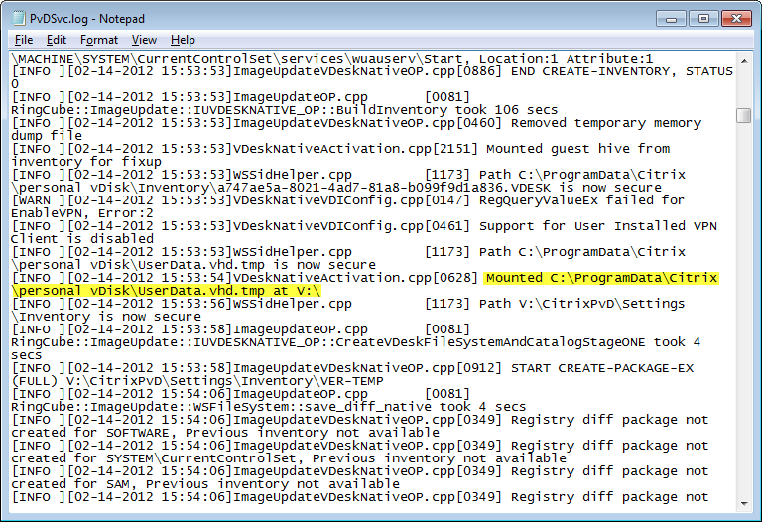
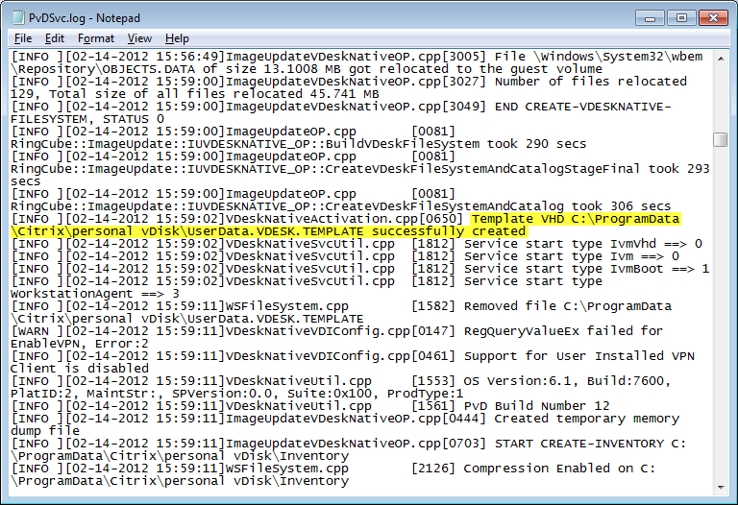
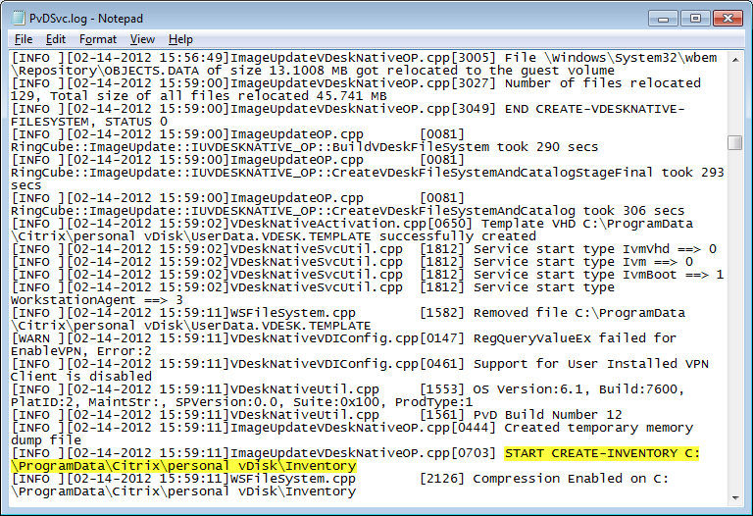
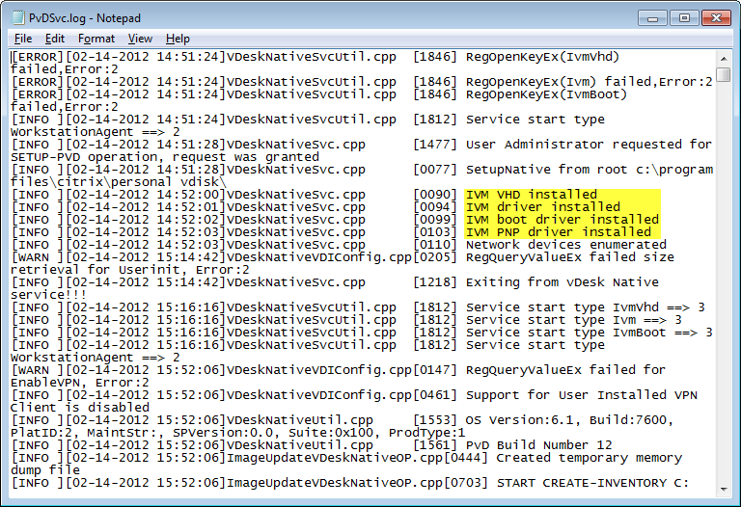
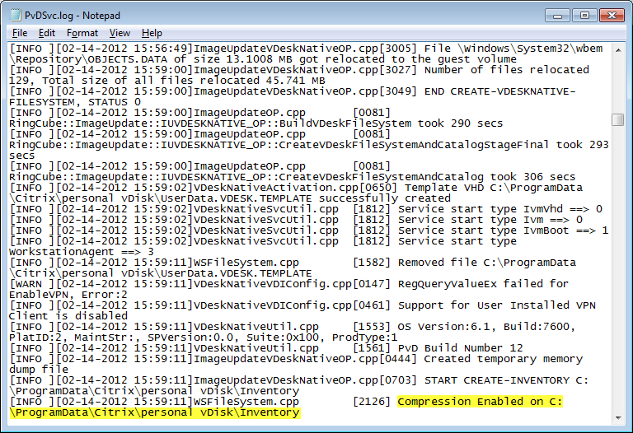
PvDSvc.log.txt - Walkthrough
Installation of drivers
Temp vhd mounted to v: to facilitate inventory process
Template vhd created as part of inventory process
Start Inventory process
Enable compression on Inventory folder
Notes:
PvDSvc.log.txt

Slide 12
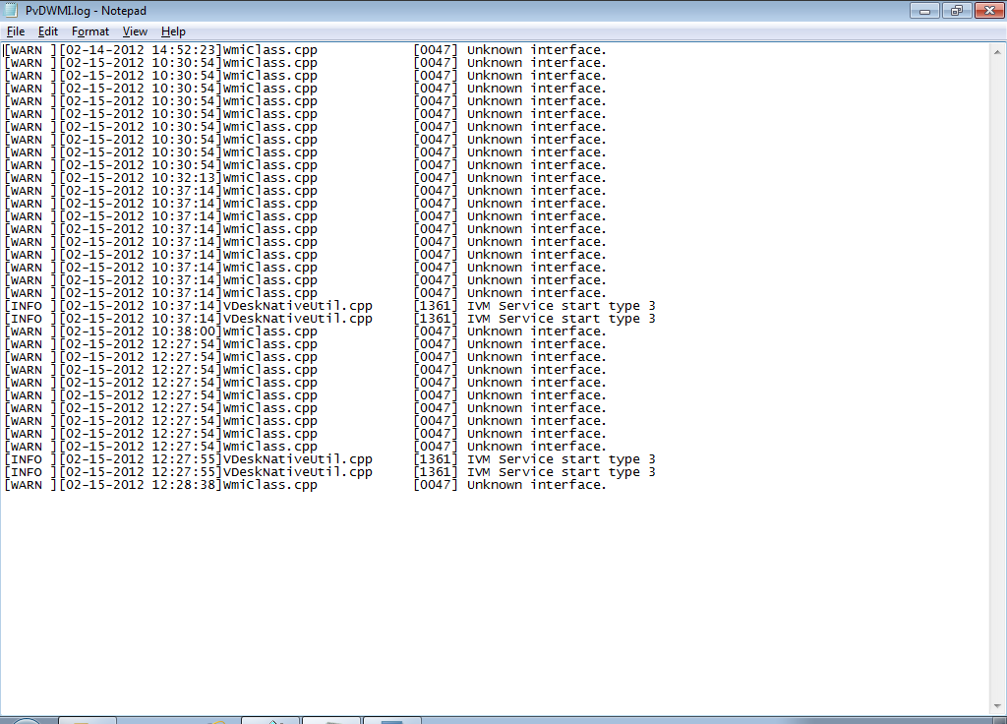
PvDWMI.log
The PvDWMI.log file records information in regards to all calls made to the PvD WMI provider i.e. PvDWMI.dll
Note: WMI provider is used by PvD drivers and indirectly by Desktop Director
Notes:
Notes:
-Hide slide for the time being…
-Log file which tracks interaction and requests to the PvD WMI provider (PvDWMI.dll)
Orig:
The PvDWMI.log file will show more information once a consumer of WMI information such as Desktop Director requests information through WinRM
Update
The PvDWMI.log file records all calls to the PvD WMI provider

Slide 13
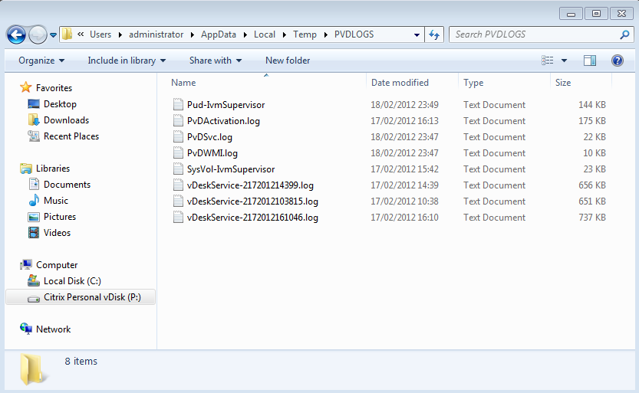
CtxPvD.exe - Automatic Log Collection
Citrix personal vDisk (CtxPvD.exe) supports the automatic collection of all PvD log files using -log switch
  %Programfiles%\Citrix\Personal vDisk\Bin\CtxPvD.exe -Log
  Created in the %Temp% directory
  Packaged as PVDLOGS.ZIP
Notes:
“PVDLOGS.ZIP” will be created will be created and placed in %TEMP% folder

Slide 14
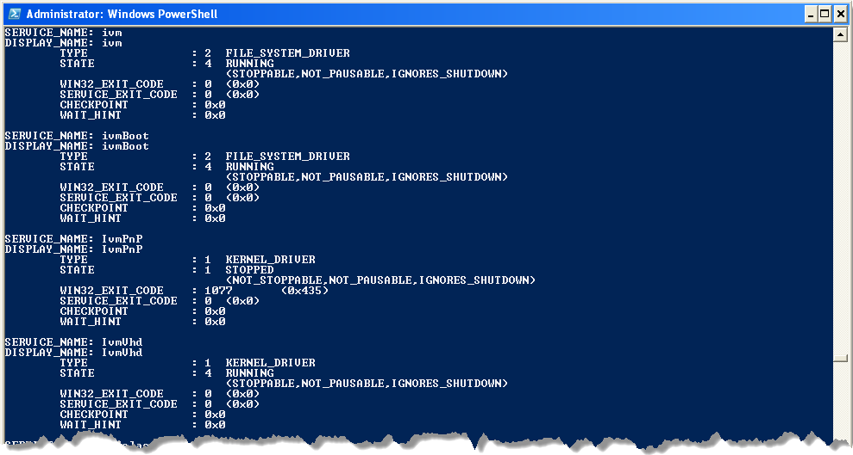
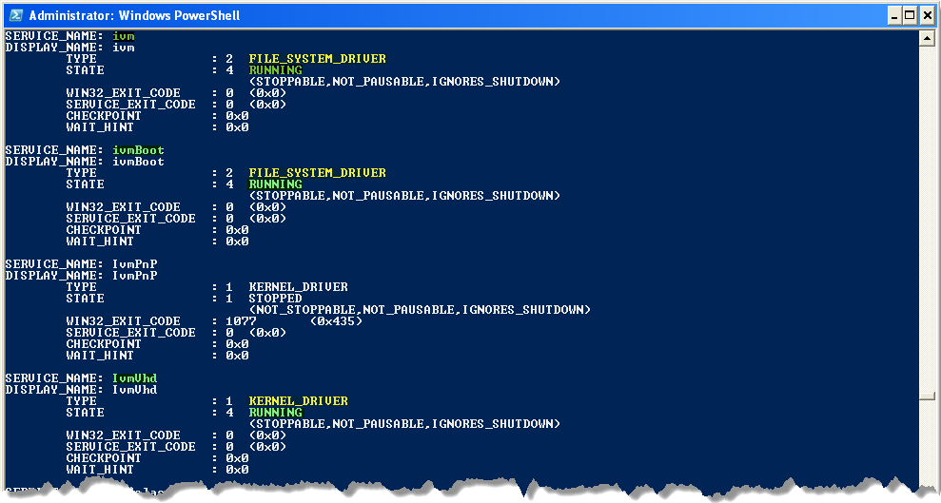
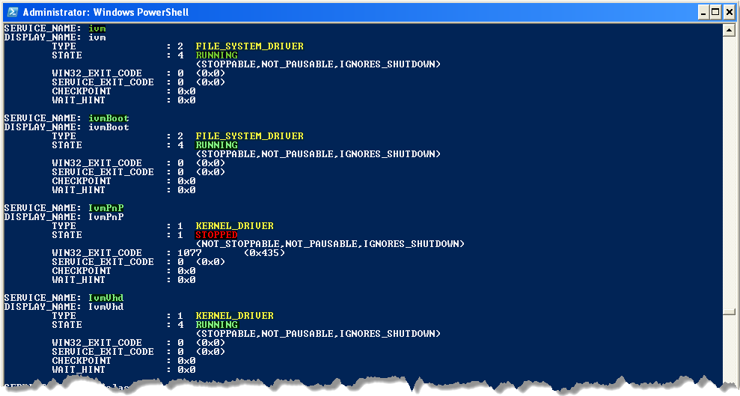
How to verify the state of all PvD drivers?
Type SC query type= driver state= all from command prompt
Notes:
SC (service controller) is a command line program used for communicating with the NT Service Controller and services. It can be used to return a list of active services including kernel and file system drivers.
Common commands:
SC query (will return list of active services and drivers)
SC query type= service (will return a list of active services including )
SC query type= driver (will return a list of active drivers including the PvD drivers)
SC query type= driver state= all (will return a list of drivers including the PvD drivers)
SC query <drivername> (will return details for the specified driver e.g. “ivm”
Complete syntax examples:
sc query - Enumerates status for active services & drivers
sc query messenger - Displays status for the messenger service
sc queryex messenger - Displays extended status for the messenger service
sc query type= driver - Enumerates only active drivers
sc query type= service - Enumerates only Win32 services
sc query state= all - Enumerates all services & drivers
sc query bufsize= 50 - Enumerates with a 50 byte buffer.
sc query ri= 14 - Enumerates with resume index = 14
sc queryex group= "" - Enumerates active services not in a group
sc query type= service type= interact - Enumerates all interactive services
sc query type= driver group= NDIS - Enumerates all NDIS drivers
Note on service types:
Services can fall under different categories:
ServiceTypes
Adapter A service for a hardware device that requires its own driver.
FileSystemDriver A file system driver, which is also a Kernel device driver.
InteractiveProcess A service that can communicate with the desktop.
KernelDriver A Kernel device driver such as a hard disk or other low-level hardware device driver.
RecognizerDriver A file system driver used during startup to determine the file systems present on the system.
Win32OwnProcess A Win32 program that can be started by the Service Controller and that obeys the service control protocol. This type of Win32 service runs in a process by itself.
Win32ShareProcess A Win32 service that can share a process with other Win32 services.

Slide 15
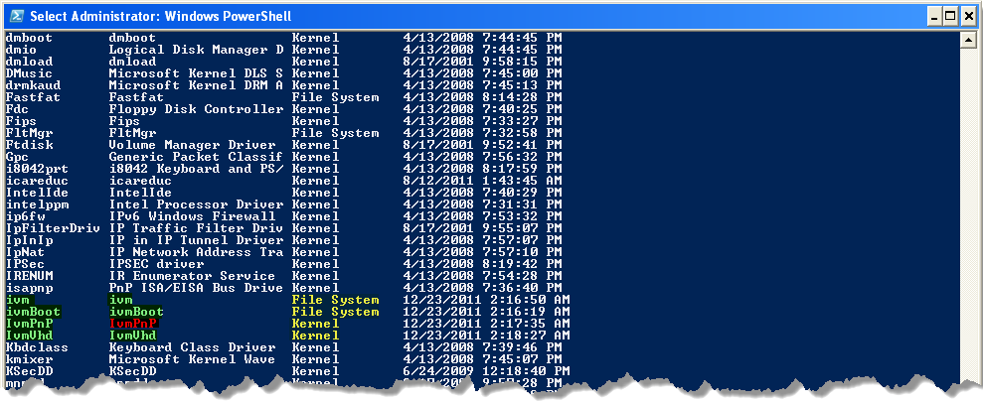
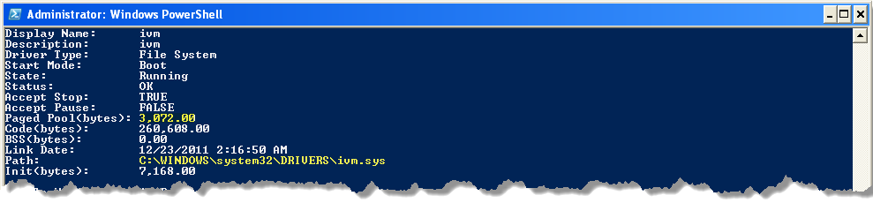
Driverquery.exe
Driverquery can also be used to view detailed information inc. start mode, memory usage & file path
Use /FO list /v switches for detailed information
Notes:
driverquery lists the installed device drivers and their properties on the system. Can be used as another useful tool for checking the state of key drivers and will return extra information on top of what SC.exe can provide e.g. location of driver on system (path)…

Slide 16
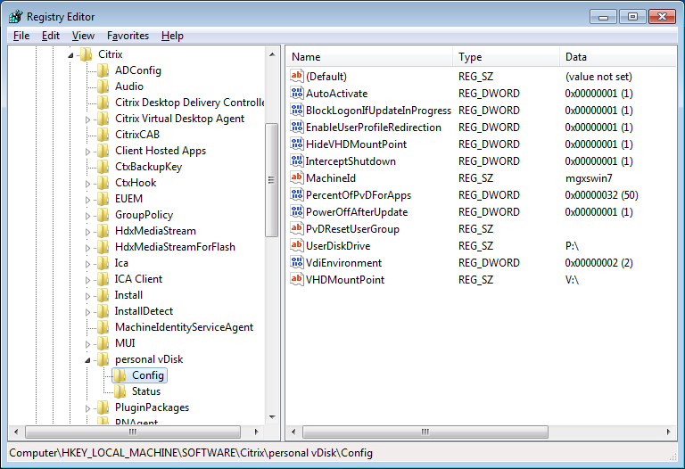
Advanced Configuration
Default PvD configuration can be altered by changing a number of values in the registry of the Base VM
HKLM\Software\Citrix\personal vDisk\Config
Notes:
AutoActivate
BlockLogonIfUpdateInProgress
EnableUserprofileRedirection
HideVHDMountPoint
InterceptShutdown (changing this value to 0 will disable the inventory wizard from running automatically)
PercentOfPvdForApps
PowerOffAfterUpdate
VdiEnvironment
ENV_VMWARE_VIEW = 0,
ENV_XENDESKTOP_ESX = 1,
ENV_XENDESKTOP_XENSERVER = 2,
ENV_CITRIX_PVS = 3,

Slide 17
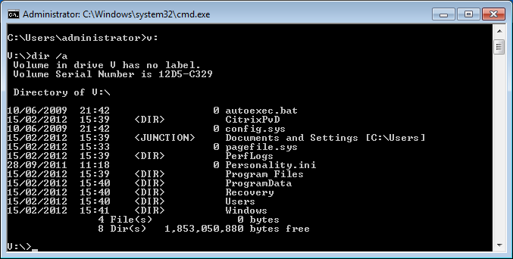
Viewing contents of UserData.vhd (V:Drive)
UserData.vhd (located on the PUD) when mounted to v: can be browsed through command prompt…
Notes:
Use Dir /a switch to show all files and folders…

Slide 18
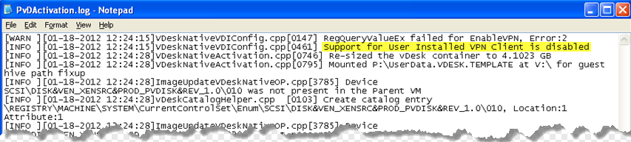
Support for end-user installed VPN software?
No - Legacy RingCube feature disabled by default with v5.6
Why?
  Breaks when used in conjunction with PVS
PvDActivation.log shows feature as disabled
Notes:
Notes:
Communication from Mike Larkin (RingCube Architect)
Ivmpnp.sys – delays the start of networking until the first user mode process (smss.exe) starts. This is/was used to support end-user installed VPN software, but quite honestly, we’re not doing much testing there or planning on really enhancing this further. It breaks when used in conjunction with PVS, and there’s really no way to fix it to work with PVS, so this functionality is disabled by default in Ibiza. It receives very minimal testing now, but really isn’t a good use case for PVD anyway.

Slide 19
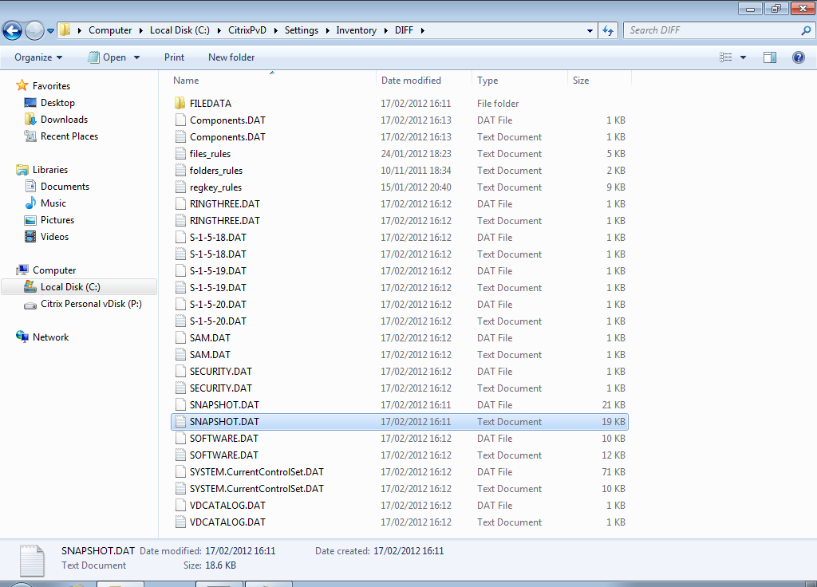
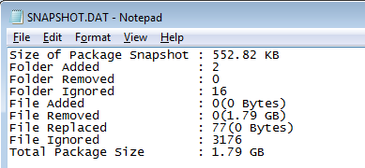
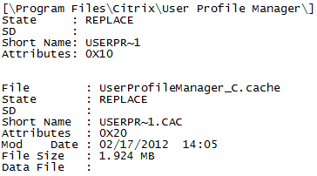
Troubleshooting Inventory updates
Review Snapshot.dat.txt located under
  C:/CitrixPvD/Settings/Inventory/DIFF
Notes:
Scenario: Application requests are being satisfied incorrectly from the base VM when collected inventory rules dictate that requests should be satisfied from PvD.
In the above situation, an admin can review the Snapshot.dat.txt collected during inventory creation or update and verify if behaviour is expected or un-expected.

Slide 20
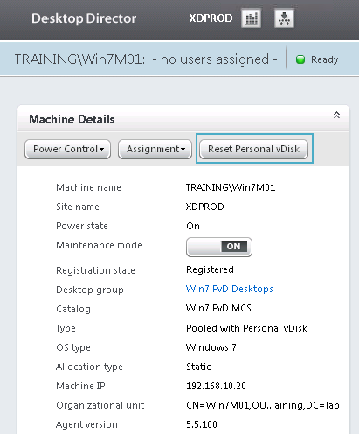
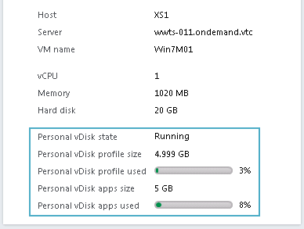
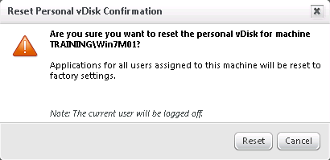
Desktop Director - Supporting PvD
Desktop Director v2.1 includes helpdesk-facing PvD metrics and support options
  % of application area in use / total size
  % of user profile area in use / total size
  PVD reset
PVD reset allows helpdesk admins to reset the application area while leaving the user’s data intact
  revert to “factory default”
  Useful to reset PVDs that become wedged due to users installing broken applications

Slide 21
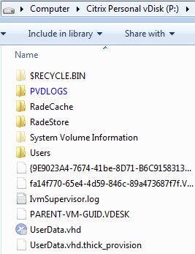
Troubleshooting PvDs that fail to start
Look in IVMSupervisor.log …
  *Remember* - this log contains early boot messages and may help isolate the problem
Boot the VM from the hypervisor
console and login
  Is the PvD present?
  Is the PvD formatted?
  Does the PvD have “proper” content
  (eg, \users folder and UserData.vhd file)
  Is the PvD full?

Slide 22
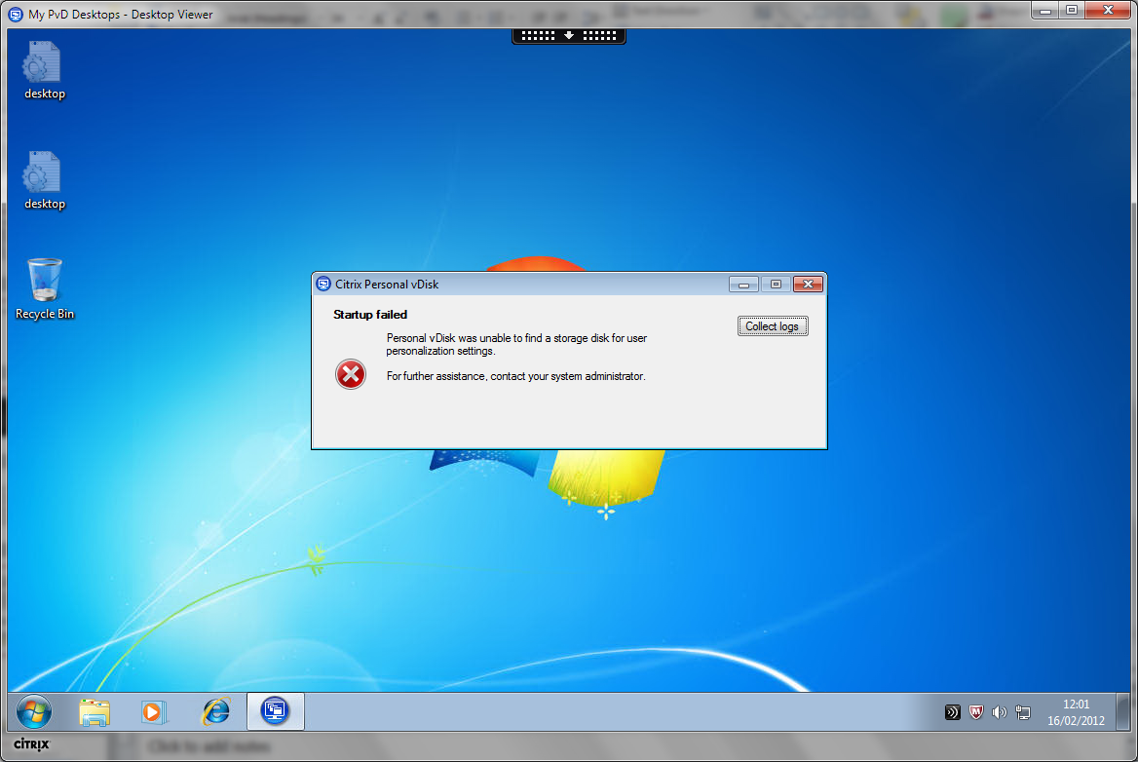
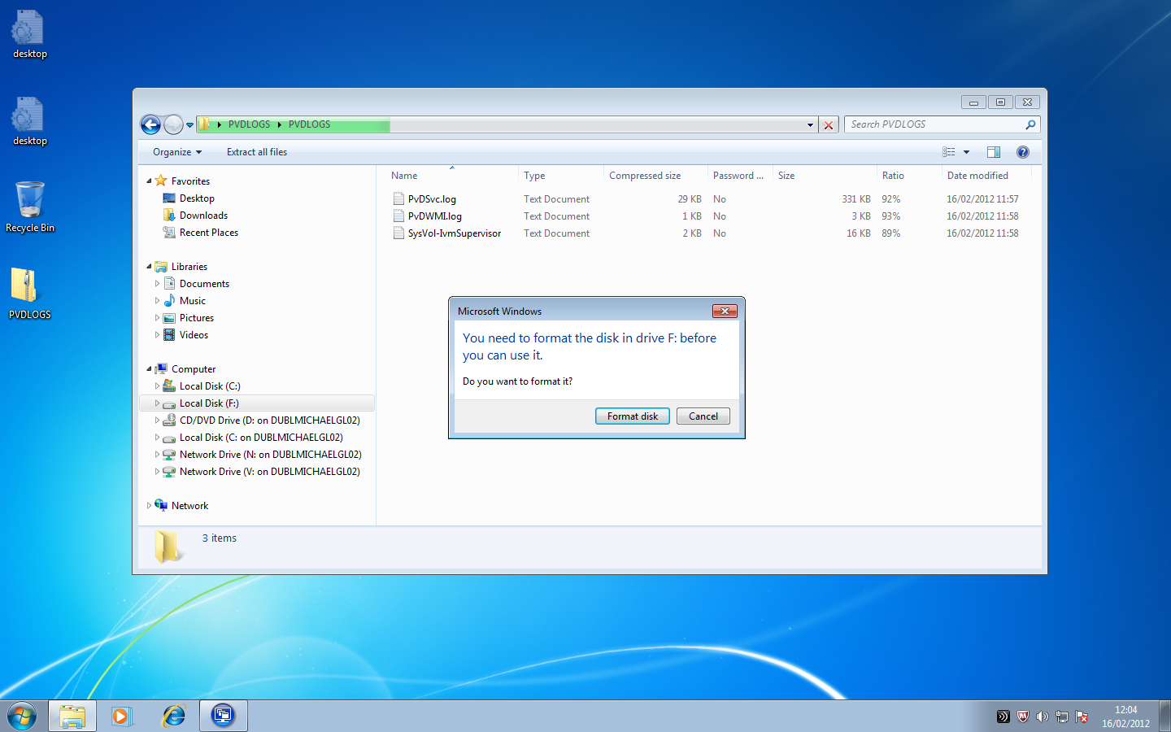
Troubleshooting PvDs that fail to start
Example: PvD fails to start and reports error that it was unable to find a storage disk for personalization settings
First Step
  Review PvDSvc.log.txt
  *CtxPvdSvc.exe is responsible for formatting the PUD*
Notes:
The above issue was encountered when the PvD VM was shutdown un-gracefully. On next boot PvD failed to start returning an error that on boot-up PvD was not able to find a storage disk for personalization settings.
Troubleshooting Steps:
-Try and browse PUD (P:drive) to validate SR
-Click collect logs option when error is first displayed or run CtxPvD.exe –log and retreive PVDLOGS.zip file under the %TEMP% directory
-Review PvDSvc.log.txt to try and verify the issue as CtxPvdSvc.exe is responsible for formatting the PUD

Slide 23
Logging Calls - What to collect?
When reporting PvD issues (PvD won’t boot, app doesn’t work, etc), collect
  … the PVD logs from the root of the PVD disk (CtxPvD.exe -log)
  … OS version and type, bitness
  … list of applications installed in the base image (appwiz.cpl)
  … list of applications installed in the PVD, if applicable
  … which hypervisor, version (XenServer, Hyper-V, etc)
  … provisioning technology (MCS, PVS) and version
PVD Support/Engineering will need this information to begin troubleshooting

Slide 24
Troubleshooting and Support - Considerations
PvDs can, in theory, be moved between VMs
  Requires administrator to use the hypervisor console and physically move the PvD volume
  Useful in cases where the user’s VM is entirely lost but In general, this is not recommended
  If absolutely required, ensure the VM image is the same or substantially similar, and try to keep the same hostname
Since PvDs are essentially just volumes in a storage tier, they can be backed up and restored like any other storage volume
  Customers should be doing this already!

Slide 25
Application Support/Best Practices
PVD KMDs load during Windows boot “Phase 1” (very early stage of OS boot)
  This means applications that load drivers during phase 0 (very very early boot) won’t work
Affected apps include certain AVs, hardware drivers, etc - but these probably shouldn’t be installed in PVD anyway
Note: These applications will work fine if installed into the base VM!
Notes:
PVD is designed so that applications installed while PVD is running should “just work” Nevertheless, there are some noteworthy exceptions and recommendations/best practices however…
Ntoskrnl.exe is the kernel image for Windows NT OS’s. It provides the kernel and executive layers of the kernel space and is responsible for various system services such as hardware virtualization, process and memory management, etc., thus making it a fundamental part of the system. It contains the Cache Manager, the Executive, the Kernel, the Security Reference Monitor, the Memory Manager, and the Scheduler, among other things.
When we talk about PVD kernel mode drivers loading at windows boot phase one we mean during phase 1 of ntoskrnl.exe initialization. This means that any application that installs or loads during phase 0 will not work with PvD.
Ntoskrnl.exe initialization is split into two phases:
-Phase 0
-Phase 1
For more information see Windows Internals 5th edition page 1088
Ref:
KDMs (Kernel mode drivers)

Slide 26
Application Support/Best Practices (cont’d)
Platform software should be installed in the base VM as a best practice
  Windows service packs and updates, etc …
Applications common to many users should be installed in the base VM
  Office, browsers, Adobe Reader/Flash, etc …

