Slide 1
Personal vDisk Architecture and Design
Shane Broomhall
APAC Readiness

Slide 2
What Does Personal vDisk Do?
PVD intercepts application I/O requests (files, registry keys/values) and redirects these requests …
  Some requests are satisfied from base VM content
  Some requests are satisfied from PVD content
PVD decides which layer to satisfy the request from based on a set of rules called the resource catalog
Resource catalog is maintained internally by PVD, and over time is updated to reflect changes in the environment
  Allows PVD to provide a blended view of both base VM image content and user changes
Notes:
Pvd consists of a minifilters…like an antivirus if you will – inspecting or looking to see what to do with resource requests.
This is done realtime inside a PVD driver.
This is based on a set of rules…found in a resource catalog.
This catalog should not be edited directly…it is a binary file maintained by PVD and updated over time.
Pvd makes sure the cat is updated to show an updated view of the rules.
We will discuss more about the catalog/rules later on…
Q- Are drivers supported with PVD?
A- Yes, PvD is a boot time technology so services, drivers etc are supported.
Pvd itself has drivers. IVM is the most important – intelligent virtual machine.
IVMs main job is to Maintain the registry catalog.
========
Pvd also has user mode services that start a little later and handles 1st time launch and any base image updates.

Slide 3
Personal vDisk Technical Internals
During VDA installation, PVD components are installed into the base VM image
  Propagates to each pool VM as well
PVD detects and treats base VM mode differently than pool VM mode
  Base VM mode allows creation of the PVD inventory and is used to perform image updates
  Inventory creation is not available in pool VM mode
Notes:
Pvd operates in two modes: It can also detect if you are an Administrator or User.
The 2 modes: Base VM Mode/Inventory Creation
Base VM mode – detects and treats base VM mode differently then pool VM mode
It allows for PVD inventory creation and image updates
Inventory creation – is not available in pool VM mode.
So what is PVD Inventory????

Slide 4
Personal vDisk Technical Internals (cont’d)
PVD inventory consists of a few things
  Resource catalog (addressed later)
  A set of 0-byte sentry files used to track metadata about files sourced from the base VM
Inventory is created as the result of an administrator action
  Start -> Citrix -> Personal vDisk -> Update Inventory
  Option is only available in the base VM
  If “Enable Personal vDisk” is selected during VDA installation, PVD will prompt the administrator to update the inventory on each base VM shutdown
Notes:
PVD Inventory consists of sentry files,
which are a few hundred mg…not large at all.
An inventory is created as a result of actions…
An admin can choose to update the inventory on the Base VM
AND
During VDA installation

Slide 5

Personal vDisk Technical Internals (cont’d)
Inventory is computed and placed in a template VHD stored on the base VM
  Contains the resource catalog and sentry files corresponding to the base VM
Template VHD is saved and used during first time pool VM use
After inventory creation, a snapshot is taken and a XD catalog is created
Notes:
The very 1st time the VM boots, the service detects the unformatted volume and formats it.
Q:How similar is this to creating vdisks in PVS?
A: Similar but we are not created actual data.
So upon inventory creation or update, a catalog is used in the base image.
On the base VM, a template VHD (Userdata.vdesk.template) is created,
and used as a template to start up the user’s PVD environment.
***During catalog creation, an empty, unformatted volume is attached to each VM.
This volume becomes the PVD for the user of that VM.
Initial size and SR (storage repositories) location are obtained from DS/PVS setup wizard
Notice also, after inventory is created, a snapshot of the VM is taken.

Slide 6


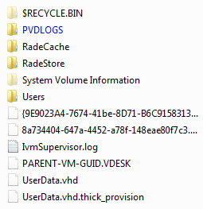
Personal vDisk - P: drive
P = P + V
Mounted as a hidden drive (v:) and captures all machine state (aka data not in c:/users) – Merged as c: drive
Notes:
The VHD created using the template is mounted as P: and in that VHD is another VHD that is mounted as V:
and is hidden and captures the applications installed/machine state.
Unfortunately this VHD on the volume is called UserData.vhd ... but it is really the machine state and not u"user data"
UserData.vhd, contains only applications. Perhaps a name change would be useful.
P = P: + hidden V:

Slide 7
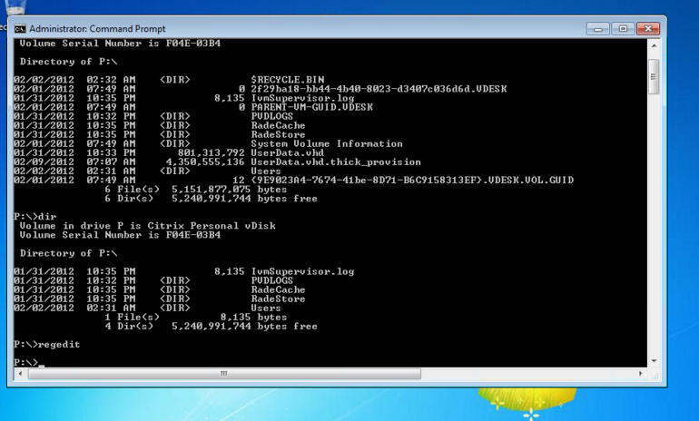
Personal vDisk Technical Internals (cont’d)
P: drive
  …physical disk attached to the VM
V: drive
  …contains info about installed applications etc
  Hidden
Notes:
The P drive is the physical disk attached to EACH VM.
The VHD file inside that comes from the original BSAE VM template and gets mounted as
V:…it is HIDDEN; holds all the information about the apps installed on the base VM etc…

Slide 8
Personal vDisk Technical Internals (cont’d)
During 1st VM boot, the PvD service detects unformatted volume and formats it
Template VHD from the base VM is copied into new volume
  VHD-inside-a-volume
If no volume is detected, the boot process proceeds
Notes:
*If no volume is detected, the boot process proceeds as the PvD service will timeout
Q: How much does this add to the VM boot time?
A: After the 1st boot, 1-2sec

Slide 9
Personal vDisk Technical Internals (cont’d)
On each subsequent VM boot, PVD performs the following tasks …
  Detect the volume with the VHD inside
  Mount the VHD
  Load the resource catalog from the VHD into the system registry
  Begin interception / virtualization
PVD will detect if the volume has increased in size and resize the VHD if needed
Notes:
On each boot…PVD performs all the listed tasks
Detect the volume with the VHD inside
Mount the VHD
Load the resource catalog from the VHD into the system registry
Begin interception / virtualization
If the volume size has increased (for example the user installed an application ect, PVD will proceed to resize the VHD accordingly.
NOTE: The broker will prohibit user logins during PVD image update workflows!
looking for is: the userdata.vhd which comes from that template created on the base VM.

Slide 10
Personal vDisk Technical Internals (cont’d)
Over time, users make changes to their environment
  Add/delete/change files
  Add/delete/change registry keys/values
  Install/uninstall software (if rights permit)
  Receive provisioned applications (eg, via SCCM)
It’s important to note that PVD captures all changes being made – these changes are redirected to the PVD VHD file
Note: No changes to the VM image are permitted, since the VM can be re-snapped back to the base snapshot at any time!
Notes:
Pvd layer captures all changes occurring on the machine.
Even those not initiated by the end user.
NOTE!!!

Slide 11
Personal vDisk Technical Internals (cont’d)
By default, the VHD is sized to be 50% of the volume size
  The other 50% is retained for user profile storage (eg, C:\users)
Split can be adjusted in the base VM before taking a snapshot
  You might want to do this if your customer is using a profile management solution – make the application space % higher in this case (say, 70% or 80%)

Slide 12
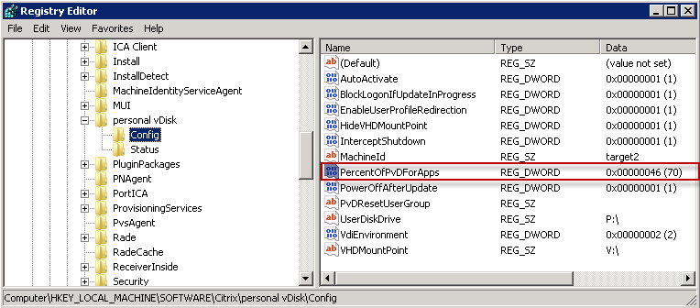
Personal vDisk Technical Internals (cont’d)
An administrator can redefine the default 50/50 split between PUD/VHD
HKLM\Software\Citrix\personal vDisk\Config
Notes:
We see hands-on in Lab.

Slide 13
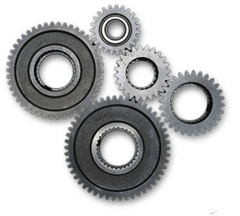
Personal vDisk Components
Personal vDisk consists of the following
Four Kernel mode drivers (KMDs)
  IVM
  IVMBOOT
  IVMPnP
  IVMVHD
Two user mode components
  CtxPvd.exe
  CtxPvdSvc.exe
Utility program
  VHDTool.exe
Note: Phase 0 drivers are not supported inside PvD.
Notes:
Personal vDisk consists of 4 Kernel mode drivers
AND
2 USER MODE components
At the Kernel Mode level,
=======
Early boot configuration is used to ensure that PVD has a chance to composite the environment before other drivers can load.

Slide 14
Component Interaction
CtxPvd.exe
VHD
VHDtool.exe
CtxPvdSvc.exe
User
IVMVHD
IVMboot
IVMPnP
IVM
Kernel
Notes:
When PVD is installed onto the base VM image …
The four drivers and user mode components are installed
The base VM’s hostname is noted
CtxPvdSvc is started
CtxPvd is started (handles inventory reminder on shutdown)
When the base VM is shutdown (after install or subsequent shutdown) …
CtxPvd.exe notices the shutdown, notifies to update/create the inventory.
The inventory is computed and placed in a pre-sized VHD file on the base VM

Slide 15
IVM
IVM is the heart of the system…
Is a Windows minifilter
  Registry filtering/virtualization via callbacks (Open/Close/Create/Set Values)
  Filesystem filtering/virtualization via minifilter attachments (Create/Open, etc)
  Has the ability to inspect/modify I/O requests
  For each resource request
    IVM determines which layer to satisfy the request from
    Achieved by consulting a resource catalog (rules) which reflects the previous computer inventory
Notes:
IVM is notified of each I/O request and decides what to do with it.
It can either pass the info along to the base vm…
OR
Rewrite the request and reissue the request back to Windows to use PVD for example.
Each request is processed by utilizing a resource catalog – will discuss Catalogs later on.

Slide 16
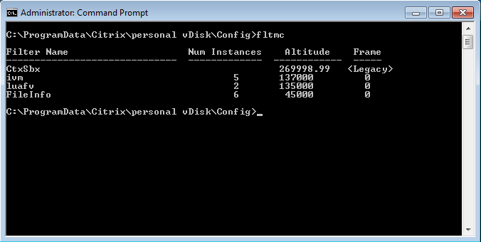
IVM (cont’d)
Granted an altitude of 137000 by Microsoft
Use ‘fltmc’ command to view a list of currently loaded drivers
Notes:
Each minifilter is allocated an altitude in the processing pipeline by Microsoft, with each type of driver requiring this type of functionality having its own grouping/altitude range.
As I/O is processed in the machine, each driver present in the list is offered a chance to inspect/modify the I/O request, from a highest-to-lowest altitude. That means drivers at the highest altitude will always see the I/O request, but it is not guaranteed that drivers at a lower altitude will (since a higher altitude driver could cancel the I/O or complete the request unilaterally).

Slide 17
IVMBOOT
Functionality is limited to the initial boot process only
Receives and process signals/events from IVM
Works to block system boot past Phase 1 until confirmation of a PvD volume can be confirmed
Notes:
This driver only works during the initial boot process.
It is a phase 1 driver, meaning it is loaded early enough to halt processes during Phase 1,
giving PVD the time it needs to get up and running for business.

Slide 18
IVMVHD
Citrix’s version of MS VHD
Works with User Mode applications
Supports Windows XP
Can be controlled via command line tool VhdTool.exe
Notes:
ivmvhd.sys provides a standard VHD volume driver that adheres to the MS VHD (but not VHDX) specification.
When RingCube was developed, it was decided to write a VHD driver,
since there was no publically-available VHD driver that supported Windows XP

Slide 19
User Mode Components
Personal vDisk contains the following User Mode components
CtxPvd.exe
  Provides a way to control the PvD Service (CtxPvdSvc.exe)
  Functionality includes image updates and interception of shutdown requests on Win7 base VMs
CtxPvdSvc.exe
  Manages image updates
  Formats PvD disk on first time startup
  Runs locally

Slide 20
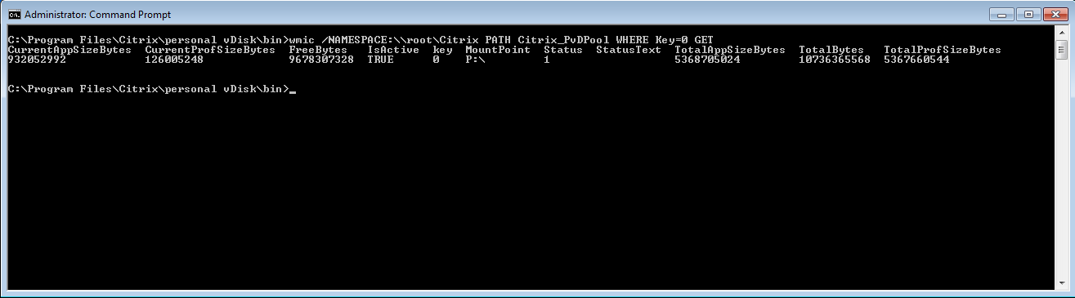
User Mode Components (cont’d)
VhdTool.exe
  Used to mount/format/dismount PvD VHD files
PvDWMI.dll
  A means to query PvD stats
    Available profile space
    Available VHD space
  Used to reset the PvD VHD
Notes:
For more examples of WMI queries that can be issued to the PVD WMI provider, consult C:\Program Files\Citrix\Personal vDisk\bin\PVDWMI.mof.

Slide 21
PvD Components in Operation

Slide 22
Pool Machine Boot
On first time boot
  CtxPvdSvc notices the PUD is unformatted
  CtxPvdSvc formats the PUD
  CtxPvdSvc copies the initial inventory VHD (inherited from the base VM) into the new PUD
  CtxPvdSvc restarts the machine
On second (and subsequent boots)
  IVM detects a volume (PUD) attachment notification
  IVM inspects the volume, looks for the correct VHD
  If found, IVM performs the PVD startup sequence
Notes:
The PUD – persistent user disk - Is the disk attached to the VM
Important to block the start up sequence for applicaton capability.
If we didn’t do this, there is a chance a driver could load before PVD was ready,
causing an inconsistent environment and undesirable functionality.
Note: IvmPMNP WAS used to block network initialization in the past. This driver no longer works!

Slide 23
Resource Catalogs
PVD consists of different types of catalogs (rules)
  Enumerated
  Inclusion/Exception
Catalogs stored as registry hive files inside the workspace VHD
  HKLM\MojoControl\FileCatalog
  Loaded by IVM during initial startup
Catalogs maintained over time by adjusting their layer indicators to reflect locations of resources
  File deletions
  Registry key additions
HKEY_LOCAL_MACHINE\MojoControl
Notes:
RESOURCE CATALOGS
PVD Contains various catalogs which contain RULES governing where to locate resources (files, keys, values etc)
that are being accessed by applications
These catalogs, physically reside inside the PvD VHD and…
are loaded by the IVM driver during startup.
You can take a look at these under HKLM\MojoControl\FileCatalog
==========
Enumeration used for file system
Inclusion used for registry
This is not for playing with by users or admins!!!
Cannot write through cache and cannot be edited by a user…changing values will not affect the way pvd operates!
RingThree used to be the name for RingCube.
AGAIN: Location 1 is PVD and Location 0 = Base VM!!!
So if an app opens one of these reg files, if the value is 1, that is telling the app to go to the PVD to get information about the application and how it should load.
objectcatalog is no longer used!

Slide 24
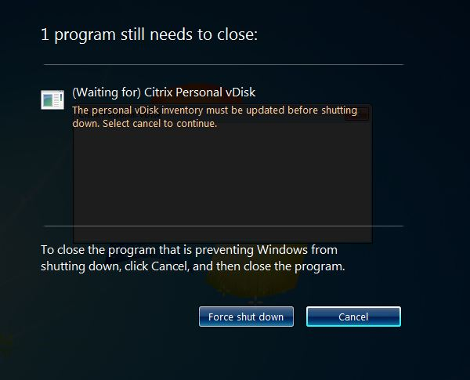
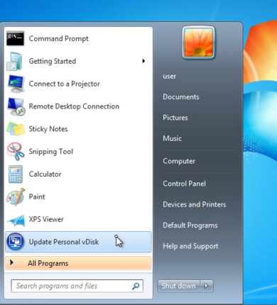
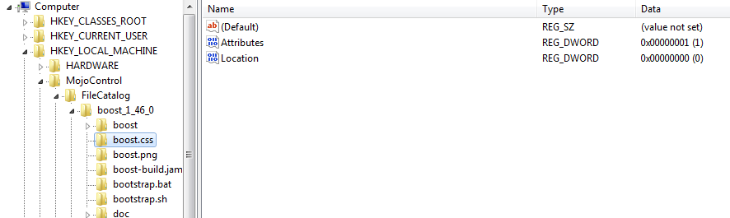
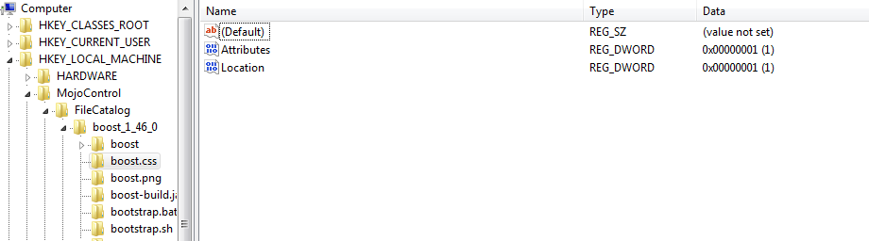
Resource Catalogs (cont’d)
Catalogs updated and patched as part of base image update
Notes:
Image Update occurs on base vm when admin selects start/all programs/inventory update OR
When the baseVM is shutdown – shown here, Win7 behavior.
Location 1 is PVD and Location 0 = Base VM!!!
So if an app opens one of these reg files, if the value is 1, that is telling the app to go to the PVD to get information about the application and how it should load.
The top diagram = before update: shows a Location of 0 which means use the Base VM to determine behavior.
The lower diagram = AFTER UPDATE…Location now= 1 which means the application should refer to the PVD for user defined behavior.
NOTE: THE BROKER WILL PROHIBIT LOGINS DURING THE pvd Image update workflows!!!!

Slide 25
IVM - Startup
During startup, IVM attaches and inspects all system disks looking for key characteristics:
  If a disk is unformatted…IVM ignores it
  A disk containing \UserData.vhd file and a GUID file that matches what is recorded in IVM’s service registry
  Change in Personal vDisk size
If a GUID match is found
  IVMVHD driver mounts the volume to the drive letter specified in the PVD software registry (V:\, by default)
Notes:
IVM’s startup routine is also responsible for detecting changes in the size of the underlying PVD disk.
The UserData.vhd file
and a GUID file that matches the GUID recorded in IVM’s service registry
Match = IVM instructs the IvmVhd to mount the volume contained in that VHD at the drive letter specified
in the PVD software registry (V:\, by default).

Slide 26
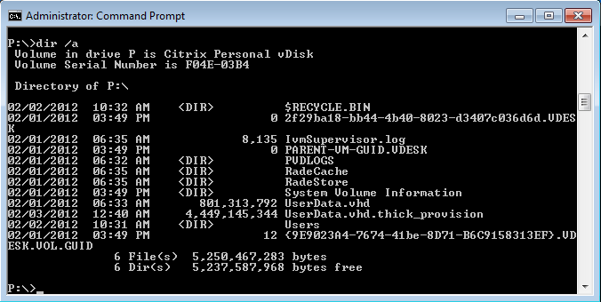
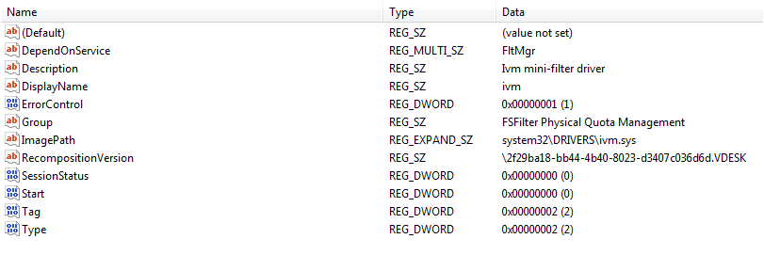
IVM - Startup
If IVM notices the inventory marker (GUID) is outdated
  It does not perform a standard startup (mounts VHD only)
  CtxPvdSvc applies the difference from the previous inventory to the user’s disk
  CtxPvdSvc updates the inventory marker and machine boot proceeds
Notes:
At image update time, the PVD service has to look at:
base VM version 1 and version 2
PVD needs to complete a 2 way merge:
Figure out what has been changed between the two base VM versions,
And look at how these differ from the user changes as well.
This is applied on each VM in the pool.
NOTE: The broker knows about these changes, so users will not be able to connect while update is occurring.

Slide 27
Disk Management
PUDs
  Created and attached via Desktop Studio/PVS wizard
  Formatted during 1st PVD boot
VHDs
  UserData.vhd contains program files content
  Consist of workspace content
  Sized separately from PUD
Notes:
P: drive = user data
V drive = application data
Userdata.vhd – contains the program files content and is sized separately from the PUD – we saw this earlier…50/50 split.
P: user data V: application data
============
(Userdata.vhd.thick_provision file is misleading…this is a placeholder to show correct amount of free space. )

Slide 28
Disk Management (cont’d)
Over time, users make changes to their environment
  Add/delete/change files
  Add/delete/change registry keys/values
  Install/uninstall software (if rights permit)
  Receive provisioned applications
It’s important to note that PvD captures all changes being made – these changes are redirected to the PvD VHD file
  No changes to the VM image are permitted, since the VM can be re-snapped back to the base snapshot at any time!

Slide 29
Disk Management (cont’d)
PUD size determines VHD size
  VHD size increases as PUD size increases/grows
Modify size of PVD in hypervisor console
  Cannot be resized while VM is running
For example …
Initial PUD size 10GB, 50/50% split
PUD
Profile (5GB)
App
VHD (5GB)
Notes:
Ibiza VHDs will adhere to an administrator-defined allocation ratio on PUD first-time format and resize

Slide 30
Disk Management (cont’d)
PUD size determines VHD size
  VHD size increases as PUD size increases/grows
Modify size of PVD in hypervisor console
  Cannot be resized while VM is running
For example …
50/50 split preserves desired allocation ratio
PUD
Profile (7.5GB)
App
VHD (7.5GB)
Notes:
Note: Can only change allocation of 50/50 split in the base VM.
This is not able to be edited by the user since user never has access to Base VM.

Slide 31
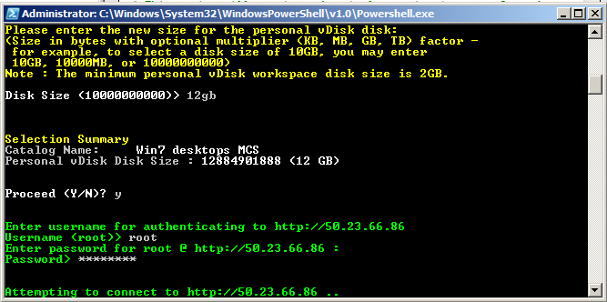
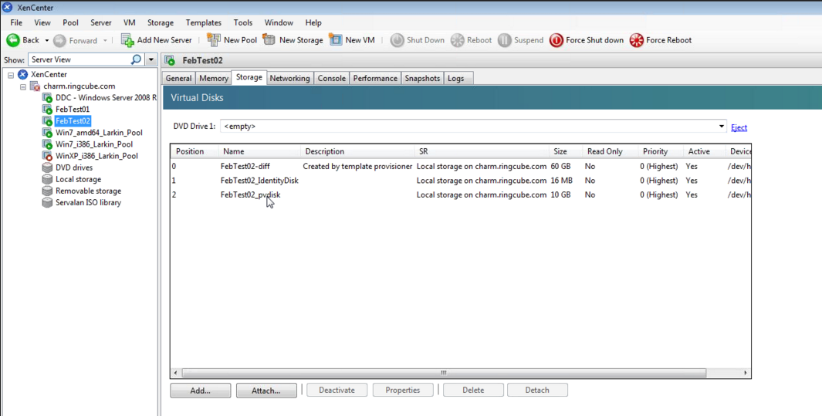
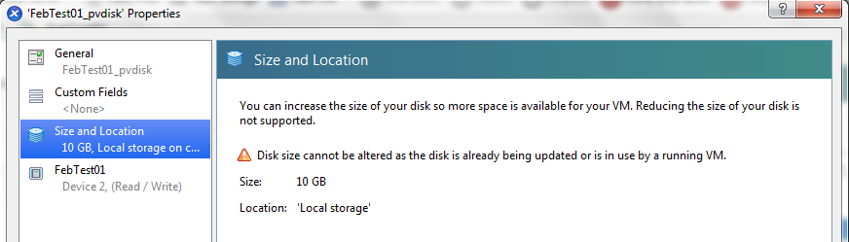
Disk Management (cont’d)
Modify size of PVD in hypervisor console
Resize-personal-vdiskpool script
  Will resize the PvD size for all VMs in a pool
  Note: Script cannot be used to reduce size of the PvD pool
Notes:
Additional methods used to modify the size of the PVD can be seen here…
In XenServer, select the VM on which the resize operation will be performed.
The correct VM for a given user can be determined using Desktop Studio or Desktop Director.
The correct disk to select will contain “_pvdisk” in the name.
Select ‘Properties’ followed by ‘Size and Location’.
If the VM is powered off (is is not in this diagram) the administrator can resize the disk and restart the VM.
PVD will subsequently detect the resize, and make the appropriate changes to the filesystem(s) and volume(s).
There is also a script provided on the install under the \support folder.
Executing the resize-personal-vdiskpool script will permit INCREASING the size of the entire PvD Pool.
Reducing size is not permitted via this method.
Q: If you try to exceed the space allocated for the PVD what happens?
A: You will get a warning!
Q/A: ProcMon will show you what is going on in the environment and is utilized by developers as a troubleshooting tool.

Slide 32
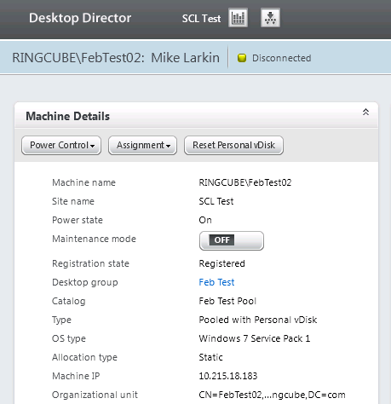
Disk Management (cont’d)
PVD VHDs can be reset externally using Desktop Director
Notes:
Remember…the VHD portion of PVD holds the application information.

Slide 33
PvDs are not differencing disks
  Differencing disks store changes as block-based differences
  PvD stores changes “fully”, eg, complete files/registry keys/values/etc.
  This key difference allows PvD to retain user personalization and merge changes across image updates (something competitors don’t yet have!)
Notes:
Differencing disk consists of a disk image with a common base containing
only a block of info that has changed.

Slide 34

FAQs
Q: If you try to exceed the space allocated for the PVD what happens?
A: You will get a warning!
Q: Can ProcMon still be employed to monitor activity in an environment?
A: ProcMon will show you what is going on in the environment and is often utilized by developers as a troubleshooting tool.

Slide 35
FAQs (cont’d)
Q: What is the CPU overhead? How fewer VMs (Win7 – current priority) will my hypervisor be able to host?
A: 20-25%! One test has seen 26%...for this release. Looking to improve on this moving forward to next releases…15% is goal for next release.
Note: XP is worse – 65% overhead)

