Slide 1
XD 5.6 Overview

Slide 2
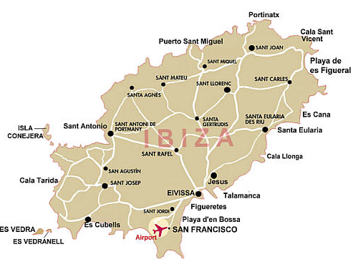

What is Ibiza?
XenDesktop 5.6
Main Focus = Integration of personal vDisk
Features
  Support for Microsoft SCVMM 2012 and SCCM 2012
  Updated Citrix License Server v11.10
  Core component* integration
  Desktop Director 2.1 (support for PvD)
  Fixed Issues
Notes:
*Ibiza will integrate PvD into the XD meta-installer, Desktop Studio, PvS, and Desktop Director…

Slide 3

Background - BIG News!!!
RINGCUBE acquisition announced at Synergy Barcelona 2011…

Slide 4
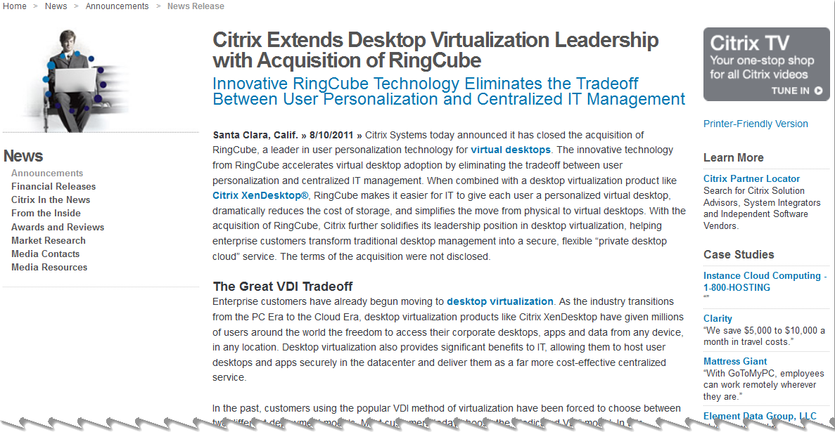
Press Release - The Great VDI Tradeoff
Notes:
http://www.citrix.com/English/NE/news/news.asp?newsID=2314908

Slide 5

The Great VDI Tradeoff - Questions to be answered…
Why is XD 5.6 good for Citrix?
  New PvD functionality increases ROI for customers which in turn helps to drive VDI adoption (Cha Ching…$$$)
Why is XD 5.6 good for Customers?
  The new PvD allows personalization settings including:
    Desktop settings & installed applications are preserved across reboots and machine updates while at the same time allowing
    Customers and admins to continue to benefit from the flexibility, ease of management and cost reduction associated with the Pooled desktop model

Slide 6

Key Requirements
XenServer 5.6 or later
  Note: SP2 required to support Intellicache™
Citrix License Server v11.10
  XenDesktop 5.6 will not work with older license servers
See eDocs for full list of requirements

Slide 7
Host and Component Requirements
XenDesktop 5.6

Slide 8
Host Requirements
XenServer | VMware
Citrix XenServer 6 Standard and Enterprise Editions (Service Pack 1 also supported) | VMware vSphere 5.0 ESX 5.0 vCenter 5.0 ESXi 5.0 vCenter 5.0
Citrix XenServer 5.6 Service Pack 2 Standard and Enterprise Editions | VMware vSphere 4.1 Update 1 ESX 4.1 vCenter 4.1 ESXi 4.1 vCenter 4.1
 | VMware vSphere 4.1 ESXi with Update 1
Note: No support is provided for vSphere vCenter LinkMode operation

Slide 9
Component Requirements (1/2)
Controller | VDA with PvD | VDA without PvD
Win2008, Standard or Enterprise Edition, SP2 (32- and 64-bit) | Windows XP 32-bit with SP 3 or later | Windows XP 32-bit with Service Pack 3 or later
Win2008 R2, Standard or Enterprise Edition (64-bit only) | Windows 7 (non-Aero) 32-bit or 64-bit | Windows XP 64-bit SP 2 or later Windows Vista (non-Aero) 32-bit or 64-bit with SP 2 or later
Win2008 R2 SP1, Standard or Enterprise Edition |  | Windows 7 (non-Aero) 32-bit or 64-bit

Slide 10
Personal vDisk (PvD)
XenDesktop 5.6

Slide 11
Personal vDisk Integration
Integrating RingCube 5.5 user personalization technology into XenDesktop 5.6
VDI with PvD offers a virtual desktop/workspace
Each user gets a workspace stored on a SAN or NAS
Workspace contains all entitlement based applications, data and settings
Workspace only contains User changes to reduce storage requirements
Notes:
entitlement based applications – department-installed apps

Slide 12



VDI Desktop Models – Assigned Desktops
User Profile & Settings
-------------
Departmental Applications
-------------
User Installed Applications
-------------
Local Peripherals
User Profile & Settings
-------------
Departmental Applications
-------------
User Installed Applications
-------------
Local Peripherals
User Profile & Settings
-------------
Departmental Applications
-------------
User Installed Applications
-------------
Local Peripherals
Increased storage
High per user cost
Increased management overhead
Complex and unique base images
Highly personalized for users
Increased user acceptance
Base Image
Base Image
Base Image
Operating System
Operating System
Operating System
VM1
VM2
VM3

Slide 13

VDI Desktop Models – Pooled Desktops
Common Base Image
No personalization
Poor user acceptance
Limited scope/user base
Reduced storage requirements
Centralized management
Uptime & predictability
Operating System
BASE / PARENT VM

Slide 14
Citrix Personal vDisk
User Profile & Settings
-------------
Departmental Applications
-------------
User Installed Applications
-------------
Local Peripherals
User Profile & Settings
-------------
Departmental Applications
-------------
User Installed Applications
-------------
Local Peripherals
User Profile & Settings
-------------
Departmental Applications
-------------
User Installed Applications
-------------
Local Peripherals
Enterprise scope
Highly personalized for users
Increased user acceptance
Reduced infrastructure requirements
Centralized management
Uptime & predictability
PvD 1
PvD 2
PvD 3
Common Base Image
Operating System
BASE PARENT VM

Slide 15
PvD Disks
PvD disks can be attached at any SR supported by the hypervisor
  For those hypervisors that support it
  Can be located on same SR as VM, or different SR
  IOPS split among storage locations
PvD default size and SR location selected in Desktop Studio during catalog creation
  PVS XenDesktop setup wizard, if PVS in use
PvD disks can be resized after initial creation

Slide 16
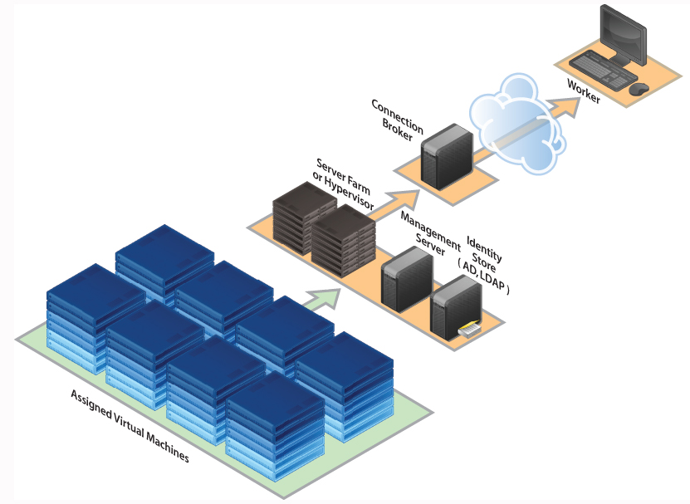
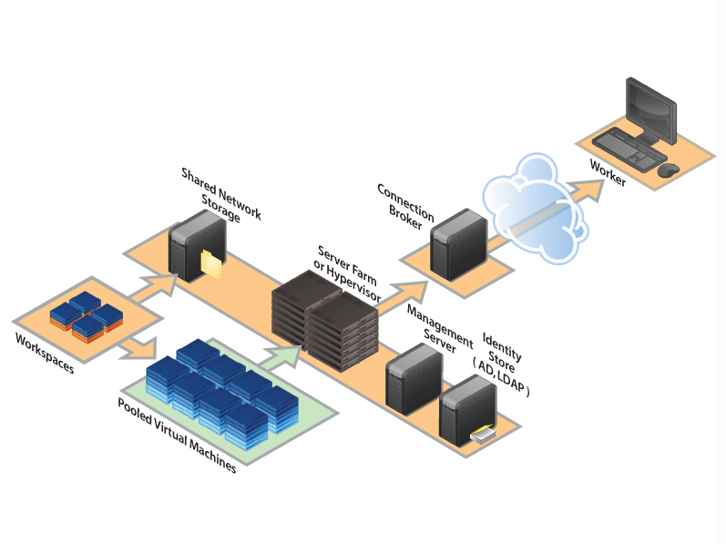
PvD Storage Architecture
Assigned Desktops
Pooled Desktops with
Personal vDisk

Slide 17

PvD Advantages
Provides full personalization for VDI
Dramatically reduces the cost of VDI storage
Can work with existing profile management tools
Notes:
Based on the preceding, the advantages are…
100% persistent personalization/ supports entitlement based applications
Reduced per-user cost by leveraging existing VDI investment
Leveraging existing skills/resources/tools

Slide 18
Installation
XenDesktop 5.6

Slide 19
Install or Upgrade?
XenDesktop 5.6 is available on disk or web download
Download consists of two images
  Full Installation
  Upgrade
Upgrade Options for
  XenDesktop 5
  XenDesktop 5 Service Pack 1
  XenDesktop 5.5
  Virtual Desktop Agent

Slide 20
Upgrade
A temporary ‘mixed’ site is permitted during an upgrade
Controllers running XD 4, 5 and 5.5 can control desktops running VDA in XenDesktop 5.6
Controllers running XD 5.6 can only control desktops running the VDA in XD 5.6.
Desktop Studio in XD 5 SP1 can manage sites created with XD 5.6 unless they include desktops with personal vDisks.
Desktop Studio in XD 5.6 can manage sites created with XD 5 and XD 5 SP1.
Notes:
Temporary ‘mixed’ site is permitted during an upgrade.
Citrix recommends limiting the time of the mixed mode by upgrading ALL components in the deployment ASAP.
Desktop Director 2.0, which was included in XenDesktop 5.5 and later, cannot monitor desktops created with XenDesktop 5.6.

Slide 21
Personal vDisk Installation
Requires XenDesktop 5.6 or later
Base VM components required
  Operating system
  XenDesktop agent
  A personal vDisk workspace
Updated Base VM
  An image update must be performed
  Updating will maintain all user specific applications/data/settings/preferences
Notes:
Requires XD 5.6
Base VM comp:
After adding the PvD to the base VM, you must perform an update to the PVD inventory.
as this Base Image will be used to create a pool where all other VM instances will come from.
**a lab could start off by updating an existing Base VM
Don’t be confused with the techpreview released with XD 5.5!!!

Slide 22
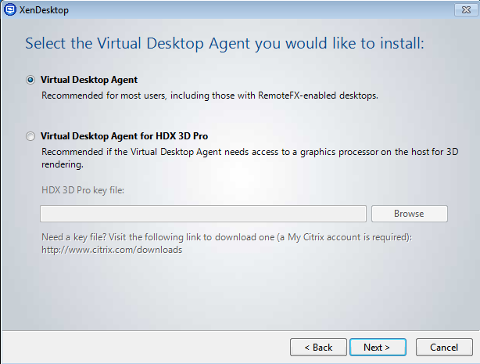
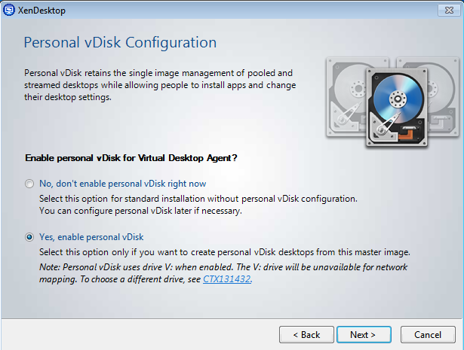
Virtual Desktop Agent Installation (1/2)
VDA can be installed in two modes:
  Virtual Desktop Agent – includes the new features of XD 5.6
  Virtual Desktop Agent for HDX 3D Pro
    Select if using Enterprise & Platinum editions to deliver graphics processing unit (GPU) for hardware acceleration
    Requires a key file – requested during license download
Enable Personal vDisk for VDA
  PVD is installed with both options here…just not turned on if ‘No,…’ is selected
Notes:
*VDA must be present on all VMs made available to users

Slide 23
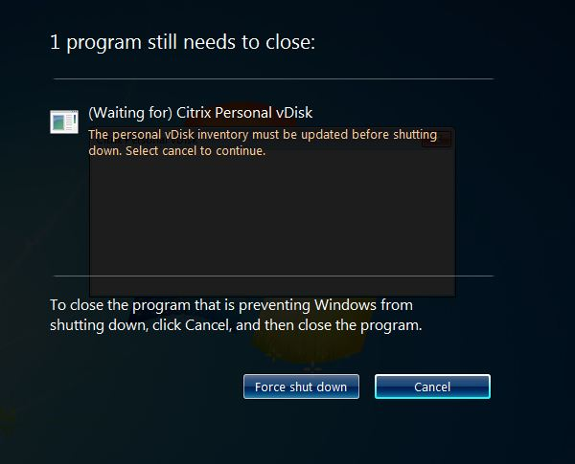
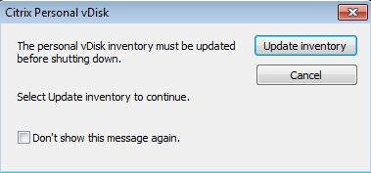
Virtual Desktop Agent Installation (1/2)
Shutdown/Reboot
  Windows 7 – click cancel when prompted and update the PvD inventory
  Uninstall any previously installed versions of the VDA before proceeding with a new install.
Notes:
*VDA must be present on all VMs made available to users

Slide 24
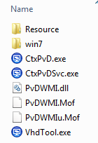
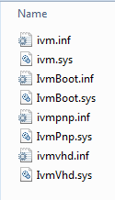
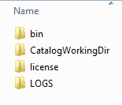
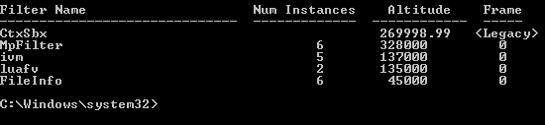

What is installed?
Notes:
We will take a more in-depth look at these bits later on during the PVD Architecture section.
The following get installed on the base VM once PVD is installed
Log files
Services
Drivers

Slide 25
Controller Installation/Upgrade
After installation/upgrade you must configure a Site involving
  Licensing
  Database set up
  Host connection
Use the Desktop Deployment Wizard to configure a site
  Quick Deploy Wizard is not for use with personal vDisks

Slide 26
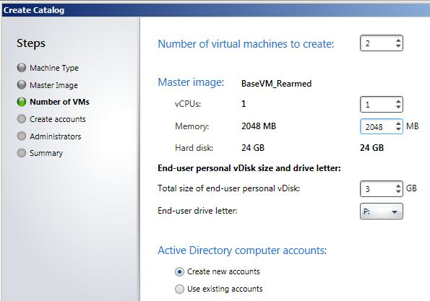
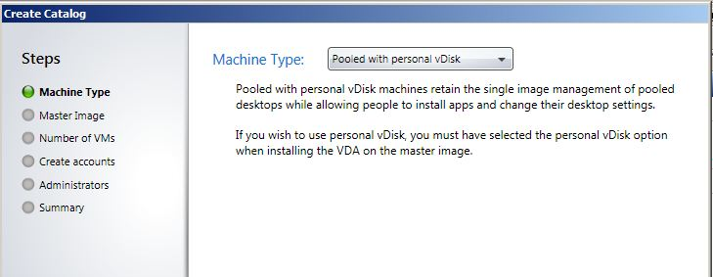
Managing XenDesktop 5.6 – Post Installation (1/2)
Personal vDisks are added when a new site is created
Create a catalog
Machine type (MCS)
  Pooled with personal vDisk
Number of VMs
Size (min of 3GB)
Drive letter
  P:
Notes:
New Hosts:
Create a catalog and take these additional steps:
On the Machine Type page of the Create Catalog wizard in Desktop Studio, select
Pooled with personal vDisk. This is a variant of the pooled-static machine type;
machines are assigned to the first user who connects to them.
For all subsequent sessions, that user connects to the same machine, and their profile and any userinstalled
applications are stored on a dedicated disk.
***Note: The Streamed with personal vDisk catalog type is also available. This adds personal vDisks to streamed machines (which load the operating system over a network from Provisioning Services). If you want to use this catalog type, do so in the Provisioning Services Console not Desktop Studio.
On the Number of VMs page, specify the size of the personal vDisk that is used for
all desktops in the catalog, and the drive letter. Ensure that the disk is big enough
to store the user's profile and any applications they install.

Slide 27
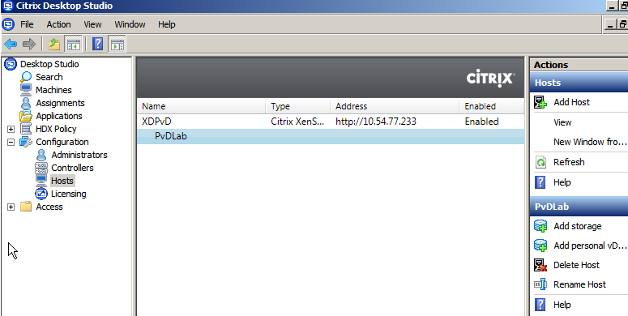
Managing XenDesktop 5.6 – Post Installation (1/2)
Add personal vDisks to existing hosts
Using Desktop Studio
  Only available with hosts created with previous versions of XD…not catalogs
Notes:
Existing:
1. In Desktop Studio, click Configuration > Hosts and select a host.
2. Click Enable Personal vDisk.
3. Click Add Personal vDisk Storage and specify the storage location.

Slide 28
Managing XenDesktop 5.6 – Post Installation (2/2)
Manage personal vDisks using command line
  Scripts located on install media
Manage virtual desktops using System Center Configuration Manager 2012
  Query properties of desktops and populate them into SCCM
  Some properties will remain null until registered with the controller
  Installed on Master VM (before or after VDA installation)
Notes:
We have a full section dedicated to SCCM later in the session.
======
When Boolean properties are displayed in Configuration Manager 2012, they
may appear as 1 or 0, not true or false.
Pre-Registration Properties that are null until registration with controller:
Host Identifier
Broker Site Name
Desktop Catalog Name
Desktop Group Name
If you upgrade Configuration Manager 2012, you may need to upgrade your base image
with the corresponding version of the client. If you don't, the new version of the client
may be installed on each pooled desktop each time it is restarted.
To allow the client-push installation to take place and for Configuration Manager to
communicate with the client, the following firewall exceptions are needed on the
Virtual Desktop Agent:
*File and Printer Sharing
*Windows Management Instrumentation (WMI)
Depending on your deployment, you may need additional or different exceptions. For
information on firewall exceptions needed with Configuration Manager 2012 and using
System Center in general, see your Microsoft documentation.

Slide 29

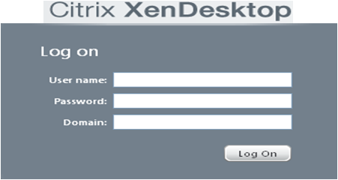













Workflow
Common Base Setup
  Install OS, common apps and VDA in base VM
  Create VM pool and entitle
User Access
  Login through XenDesktop Client
  PvD assigned on first login
    Locally administered/User installed/streamed apps
Image Update
  Update base VM without affecting any user personalization
User’s Workspace
Common Base Image
Operating System
Notes:
So the workflow to get a PvD environment up and running looks like this…
We will visit a full section dedicated to PvD Architecture.

